Slide 1

Container And Orchestration Tools IN Cloud Computing
Name :- Sreenath Reddy Kurukunda
KSU ID :- 811211580

Slide 2
What is Containers ?

Slide 3
Containers
Containers are packages of software that contain all of the necessary elements to run in any environment. In this way, containers virtualize the operating system and run anywhere from a private data center to the public cloud or even on a developer's personal laptop.

Slide 4
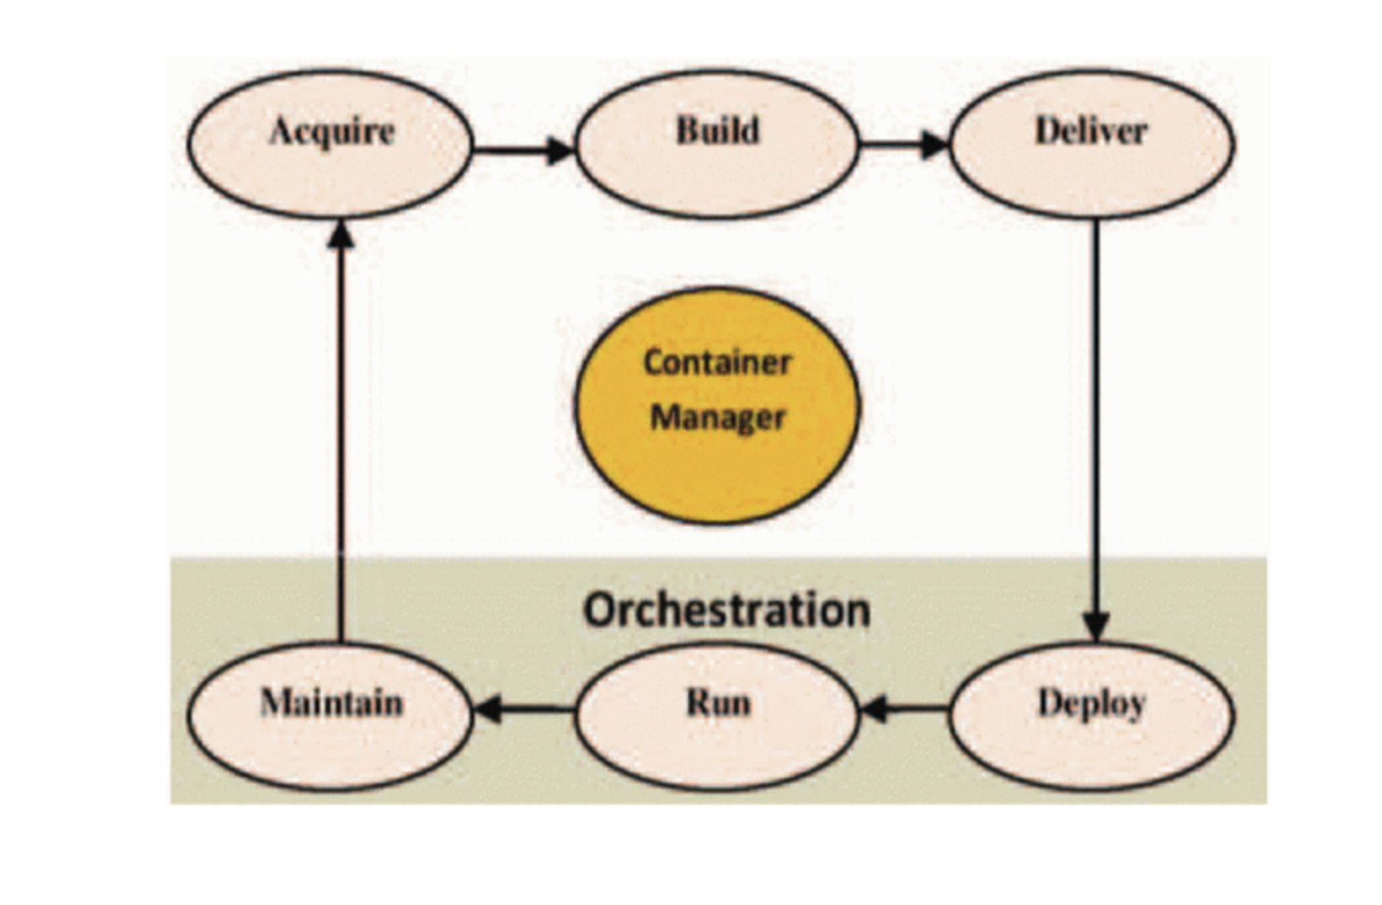
Lifecycle of container

Slide 5
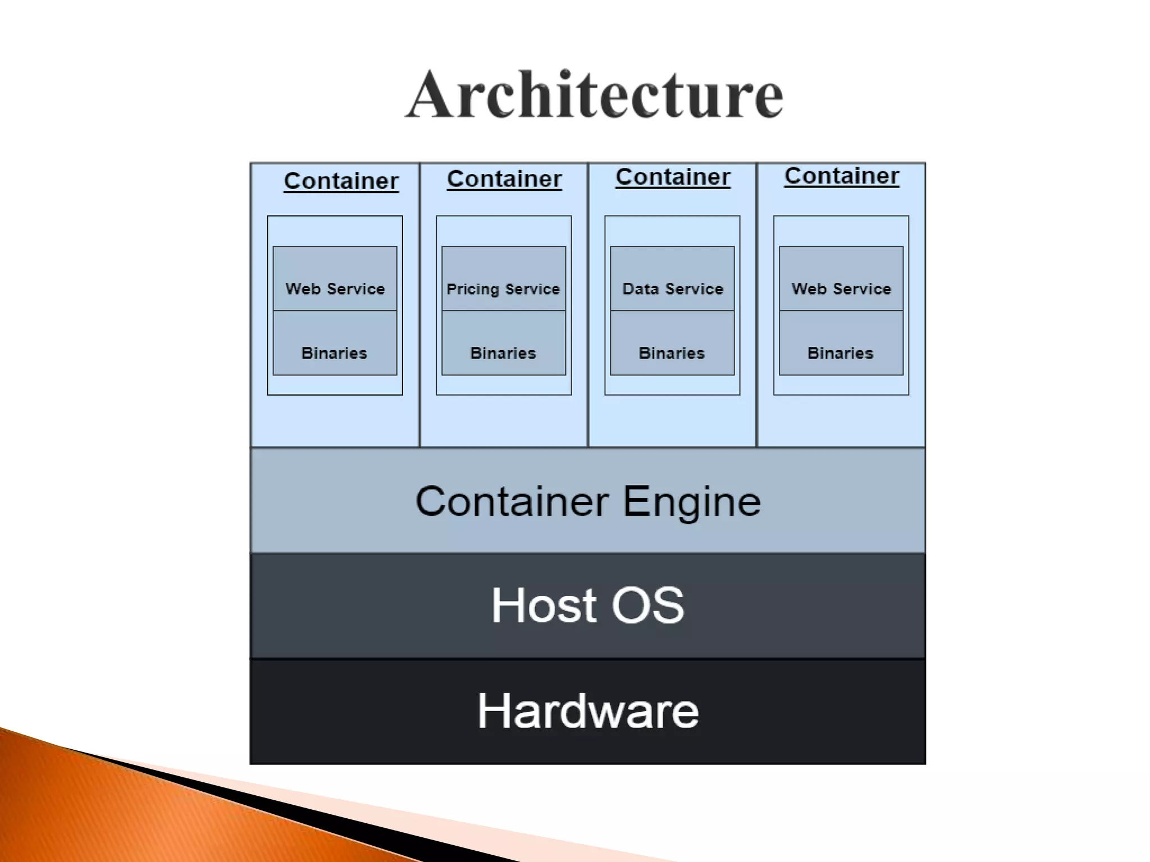
How Containers Work?
﻿﻿Each container is an package of software, running on top of a host OS. A hosts) may support many containers (tens, hundreds or even thousands).
﻿﻿At the bottom, there is the hardware including its CPU, disk storage and network interfaces.
﻿﻿Above that, there is the host OS and its kernel - the latter serves as a bridge between the software of the OS and the hardware.
﻿﻿﻿﻿At the very top are the binaries and libraries (bins/libs) for each application and the apps themselves, running in their isolated user spaces (containers).

Slide 6
Benefits
Applications can consist of tens, hundreds, or even thousands of containers with cloud contains, you can distribute and manage these containers across many different cloud servers.
Simplified application deployment
Flexibility
Separation of responsibility
Scalability
Resiliency
workload portability

Slide 7
Orchestration Tools
There are so many orchestration tools. This are widely used orchestration platform in the IT industry are .
Kubernetes
Docker Swarm
Apache Mesos
RedHat and OpenShift

Slide 8
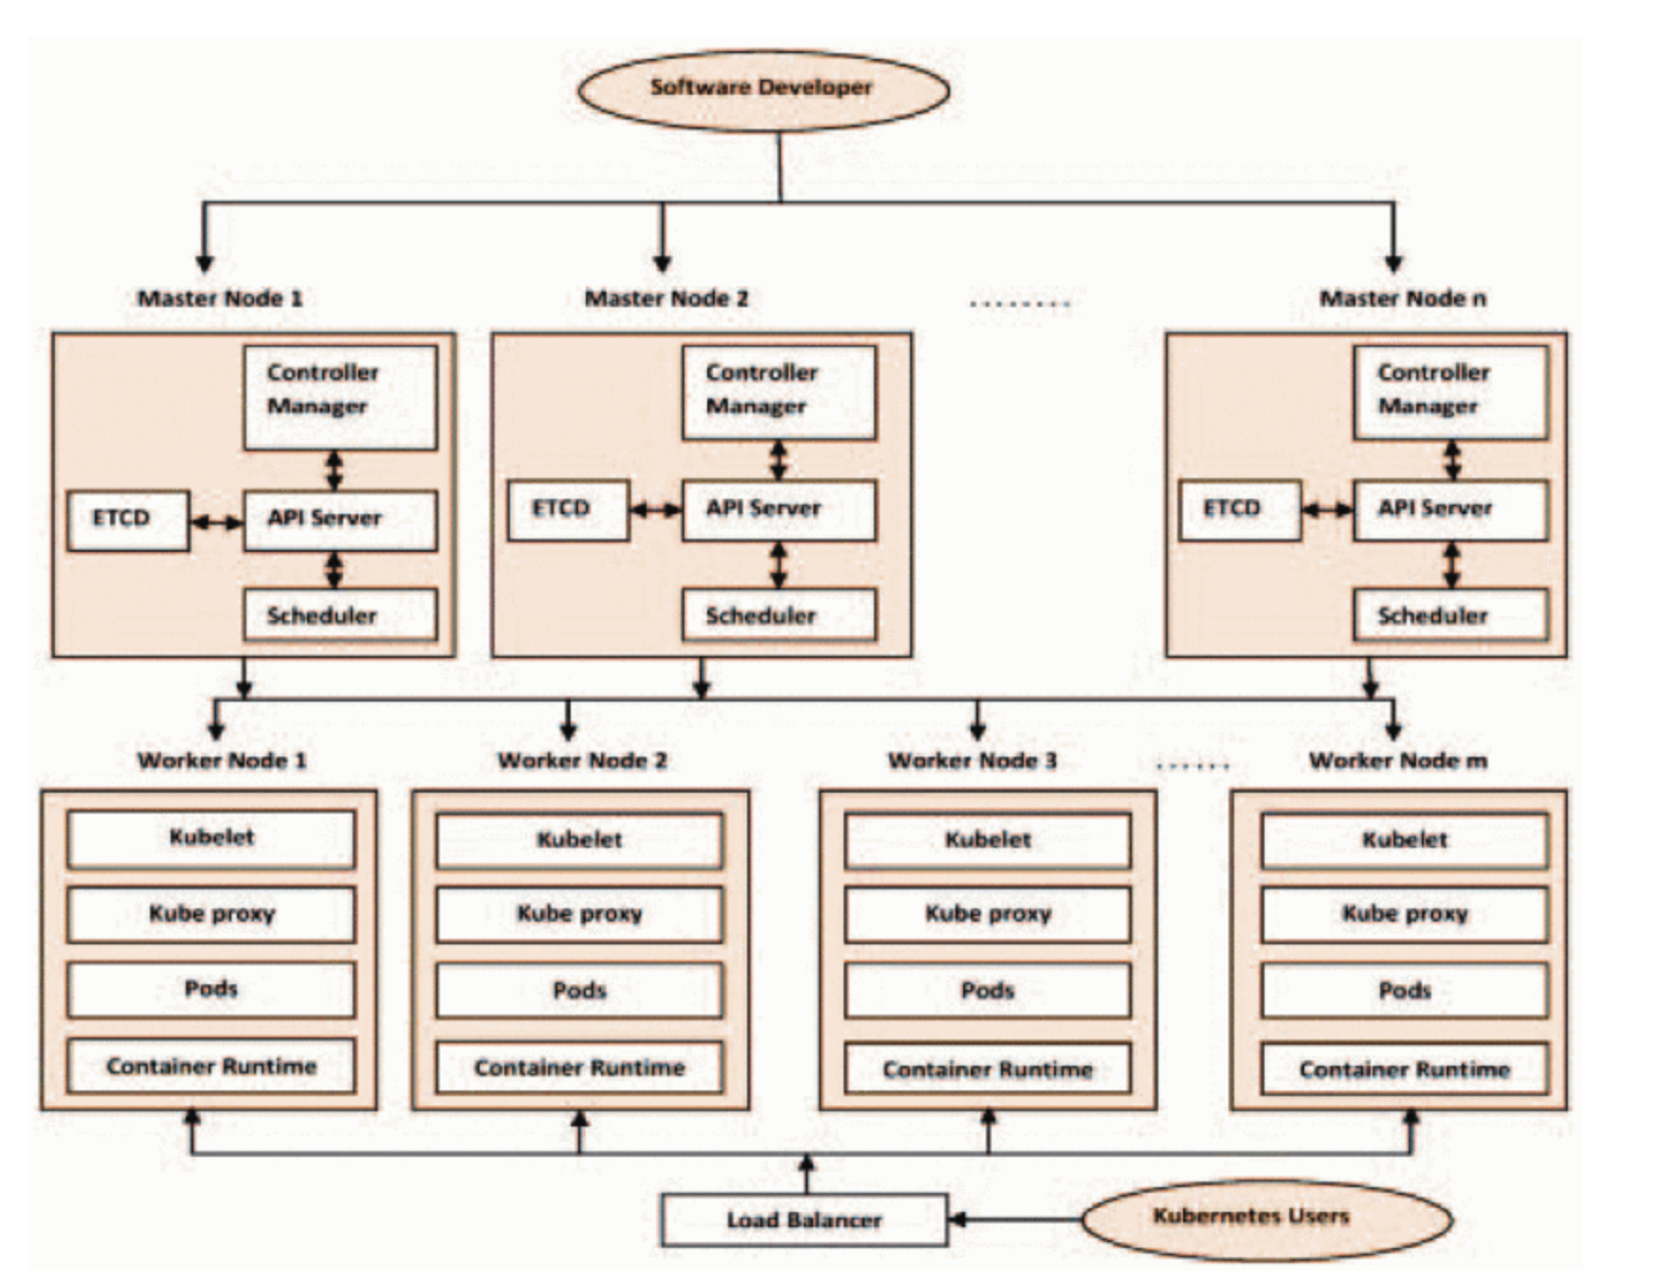
Kubernetes
It is an open-source orchestration tool of containers developed by Google in 2008.
In 2015, this tool was given by Google to Cloud Native Computing Foundation.
At present, it is the most widely used orchestration tool.
The containers are orchestrated using YAML and JSON files in Kubernetes.

Slide 9
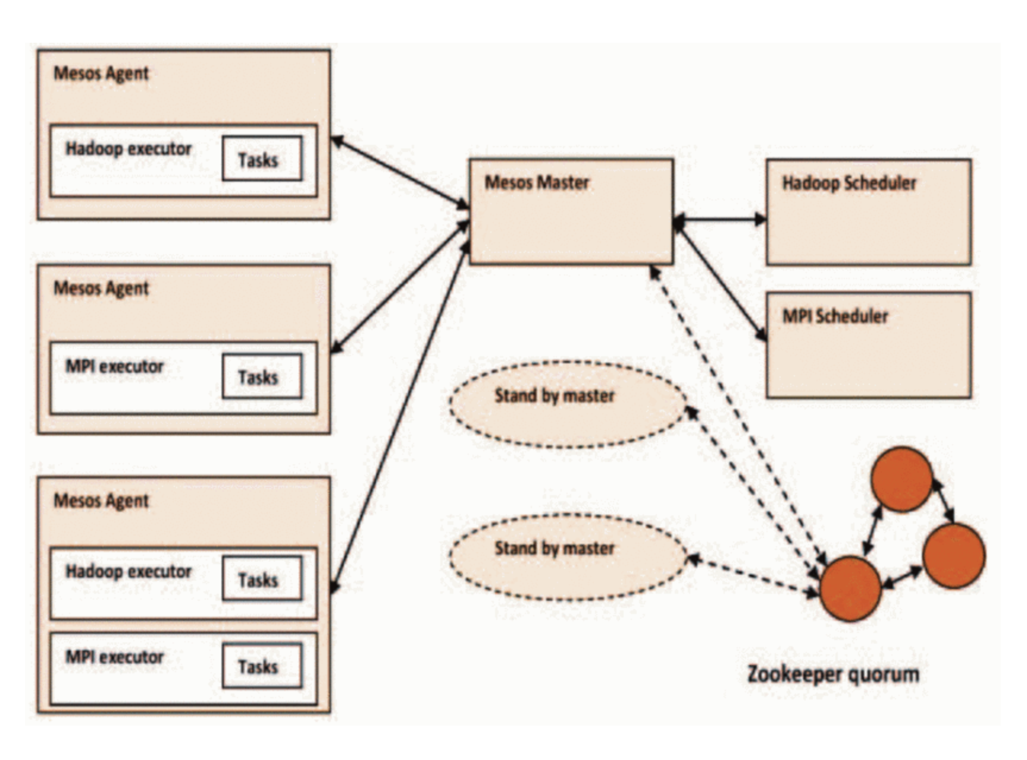
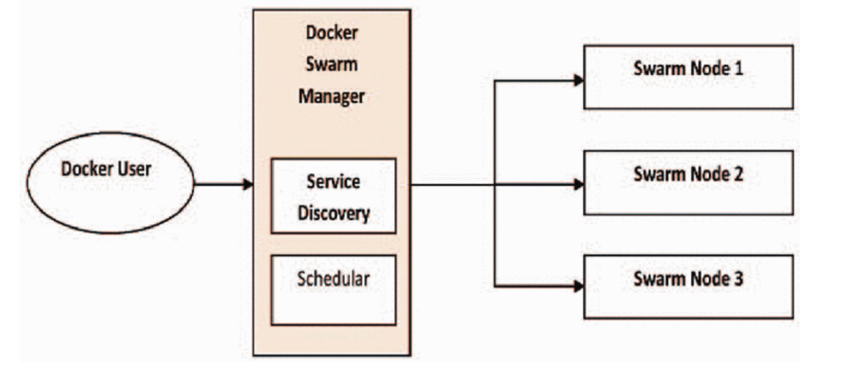
Apache Mesos
Docker Swarm

Slide 10
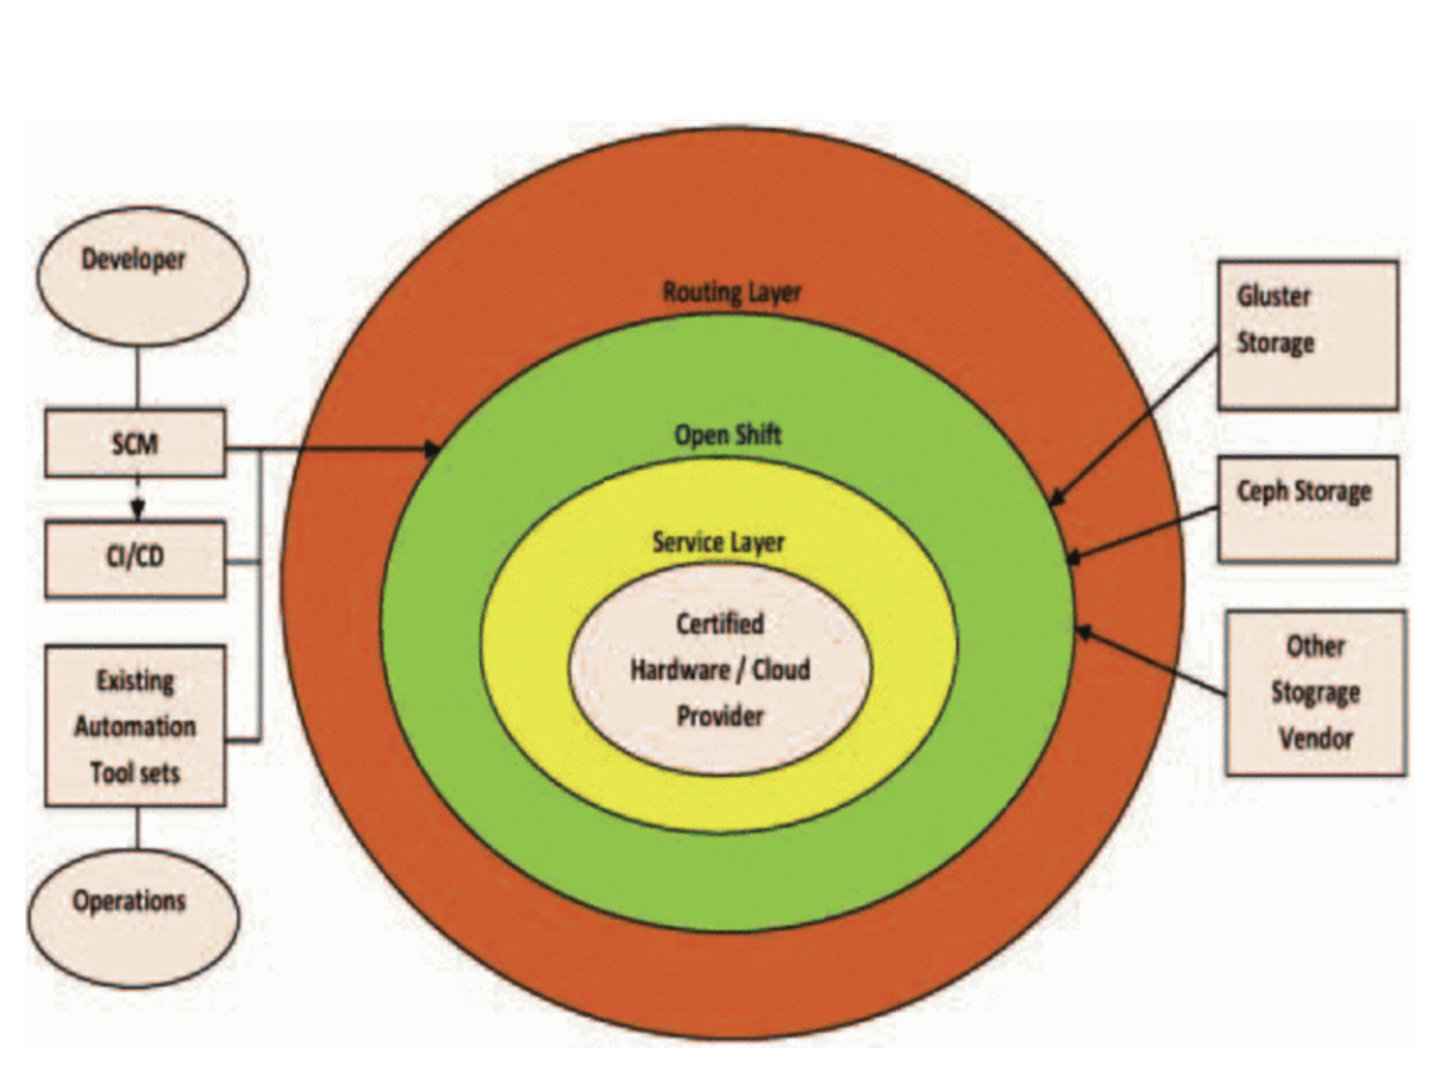
Openshift
Red Hat helps to purchase many guaranteed applications which in turn helps in billing, visibility, administration, and responsive support.
Platform-as-a-Service (PaaS) and Container-as-a-Service (Caas) both are offered by OpenShift.

Slide 11
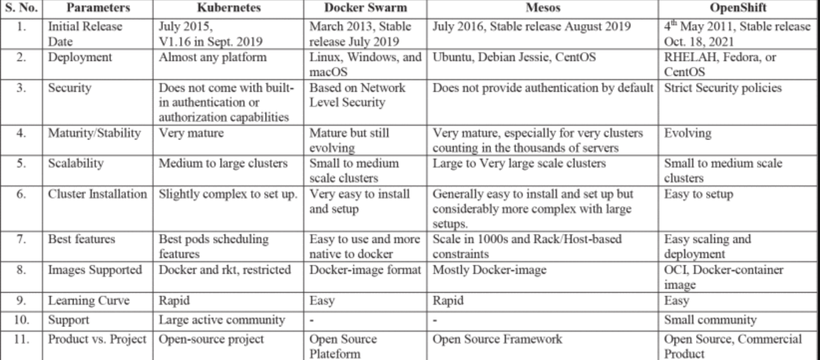

Slide 12
Containers services
AWS
Google
Google Kubernetes Engine (GKE)
Cloud Run
Cloud Build
Run containerized applications or build microservices | Amazon Elastic Container Service (ECS)
Manage containers with Kubernetes | Amazon Elastic Kubernetes Service (EKS)

Slide 13
Conclusion
The four popular orchestration tools viz., Kubernetes, Docker Swarm, Mesos, and Redhat OpenShift. Kubernetes has the best scheduling features whereas Docker Swarm is easy to use. We also noticed that Kubernetes is the most popular and widely used platform among the tools discussed in this paper. We also found that the second most popular orchestration tool in the IT industries is OpenShift.

Slide 14

qUESTIONS ?

Slide 15

tHANK YOU

